Slide 1
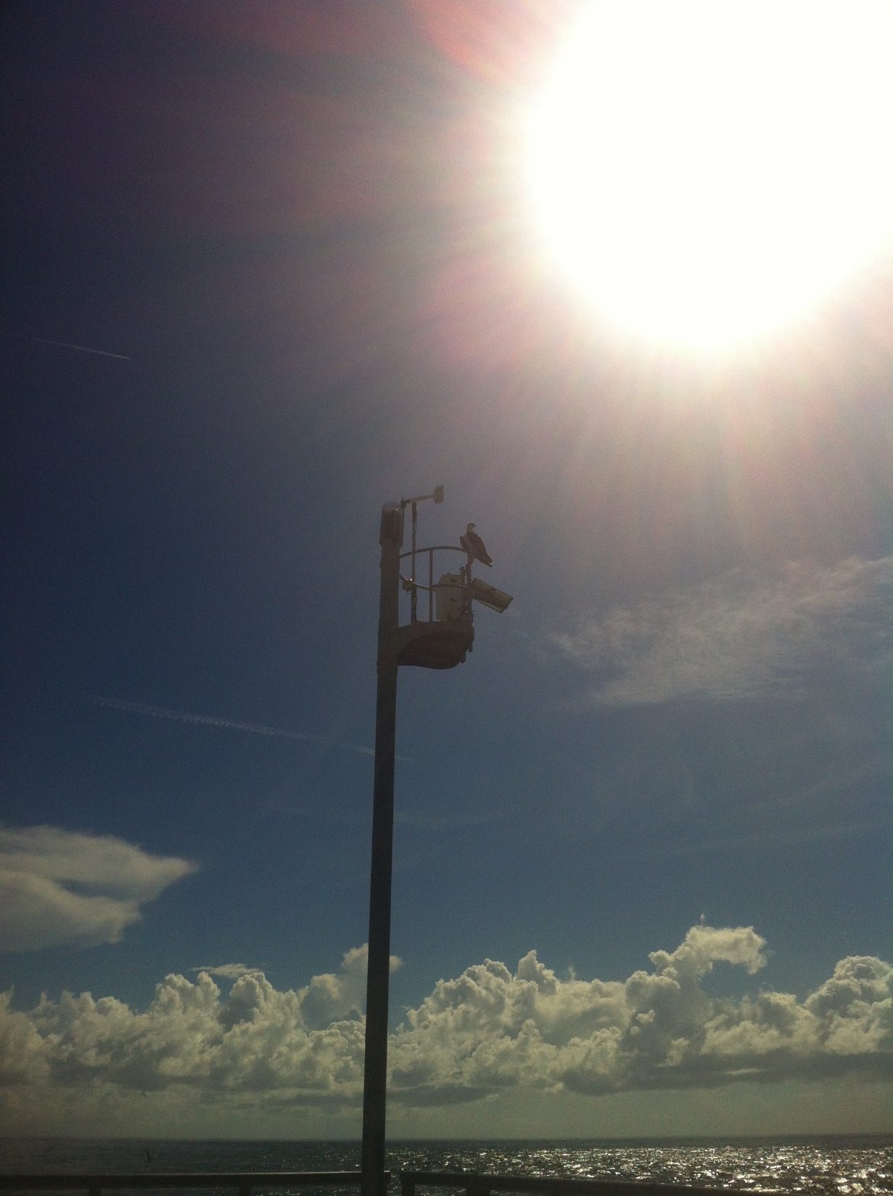


Sebastian Inlet District Oceanographic and Meteorological Monitoring Program
2020 – 2021
Prepared for
Sebastian Inlet District
114 Sixth Avenue
Indialantic, Florida 32903
Prepared by:
Gary A. Zarillo
Marc Di Ciccio
Florida Institute of Technology
Department of Ocean Engineering and Sciences

Slide 2
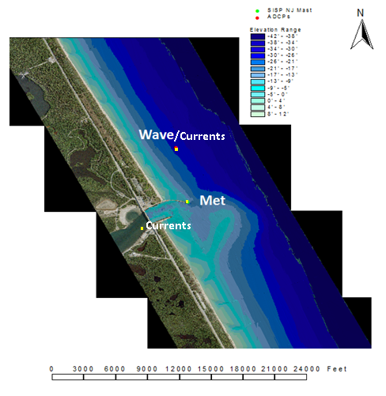
Permanent Sensor Locations

Slide 3
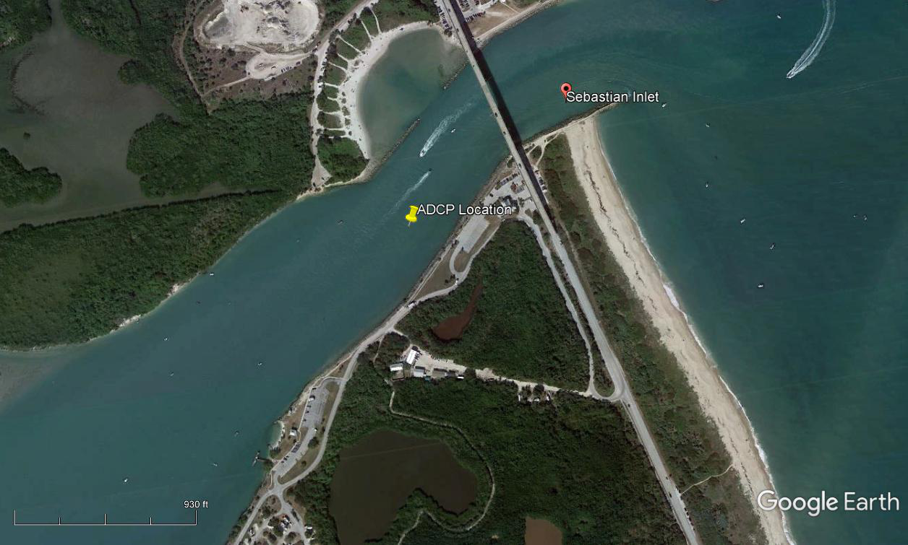
ADCP Sensor Location
USACOE Permit

Slide 4
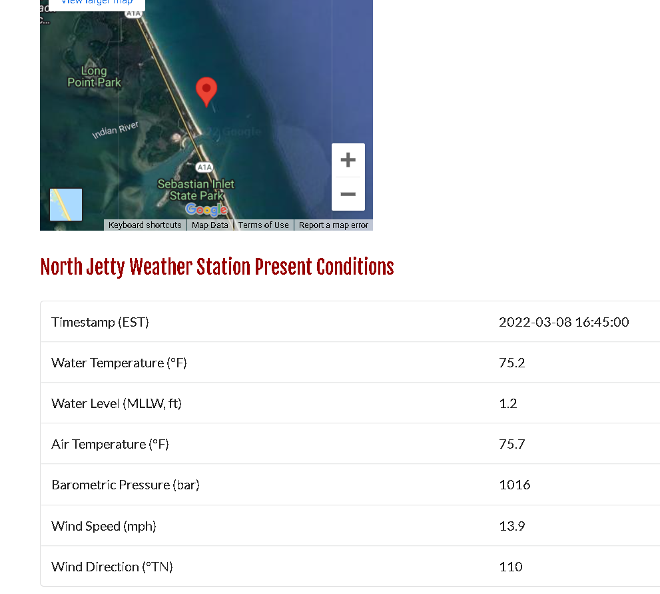
March 8th 2021 North Jetty Data: 1645

Slide 5
Data Links
Florida Institute of Technology webpage
  http://research.fit.edu/wave-data/index.php.
South East Coastal Ocean Observing Regional Association’s webpage (SECOORA)
  https://www.portal.secoora.org/
NOAA’s National Data Buoy Center (NDBC) website
  http://www.ndbc.noaa.gov/station_page.php?station=sipf1.
Florida Tech Real Time Sebastian Inlet Model
https://realtimefl.github.io/Sebastian_Inlet/

Slide 6
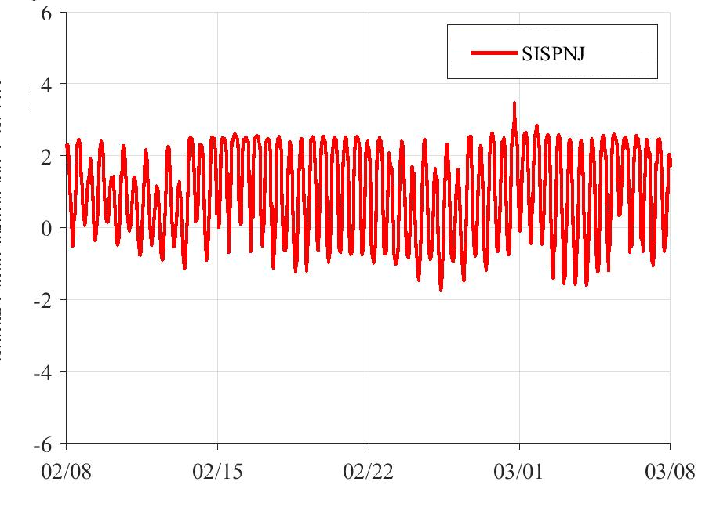
Water Level Data: 4 weeks
Water Level Above MLLW

Slide 7
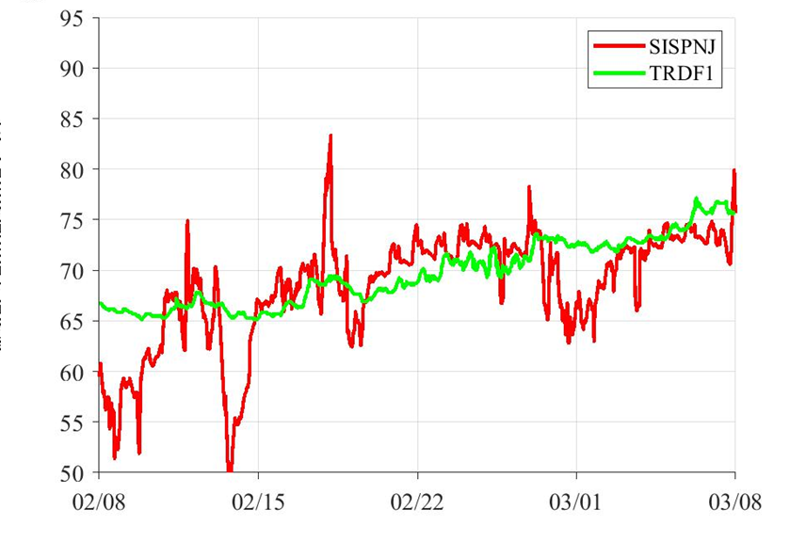
Water Temperature Data: 4 weeks
Water Temp. Deg F

Slide 8
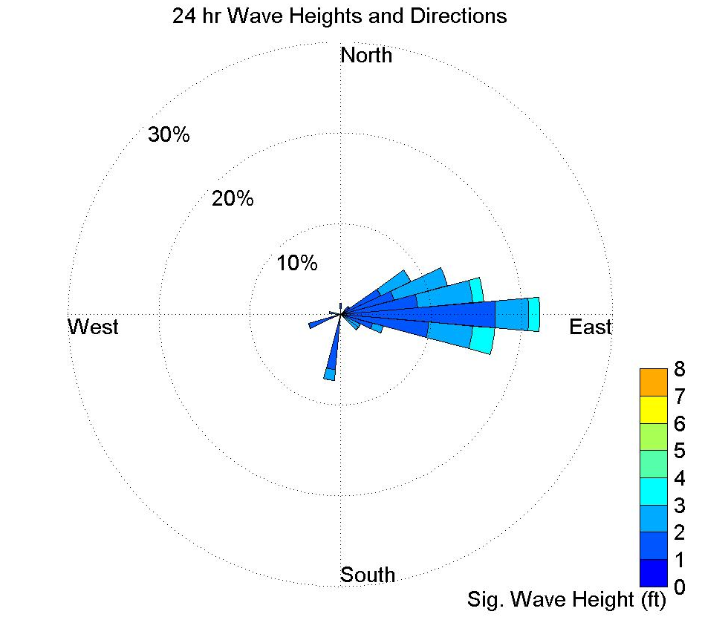
Significant Wave Height: 4 weeks

Slide 9
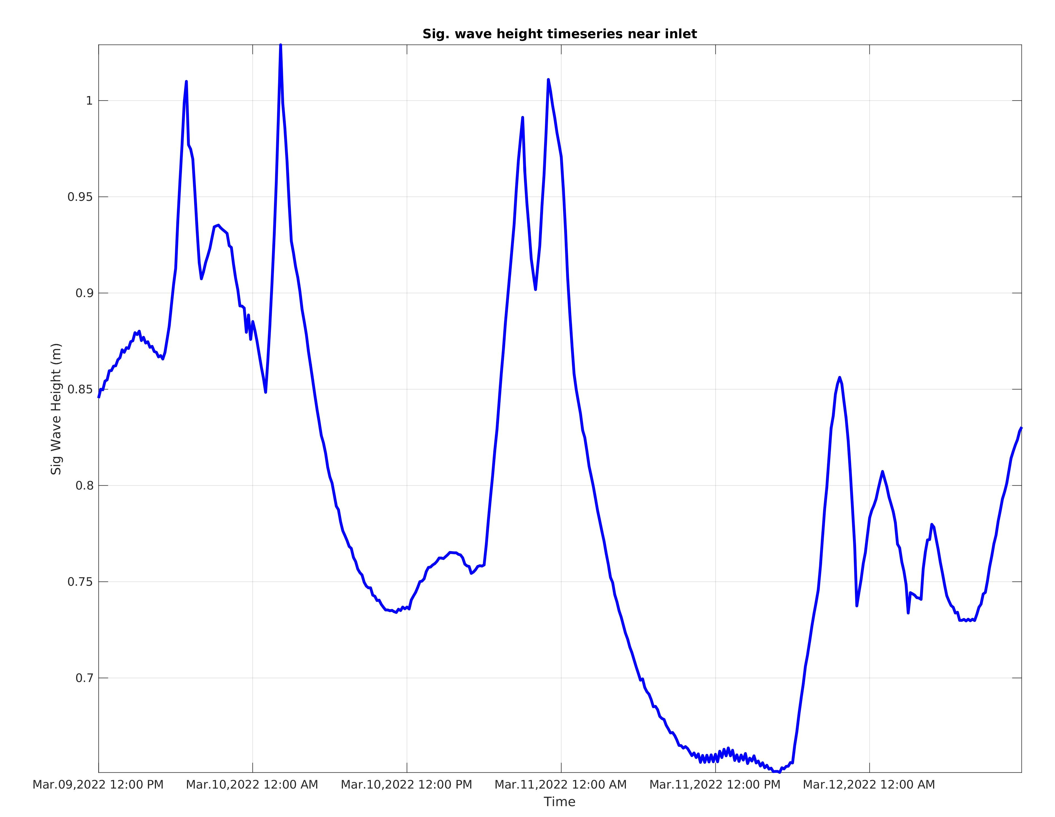
Significant Wave Height Forecast: 72-Hours

Slide 10
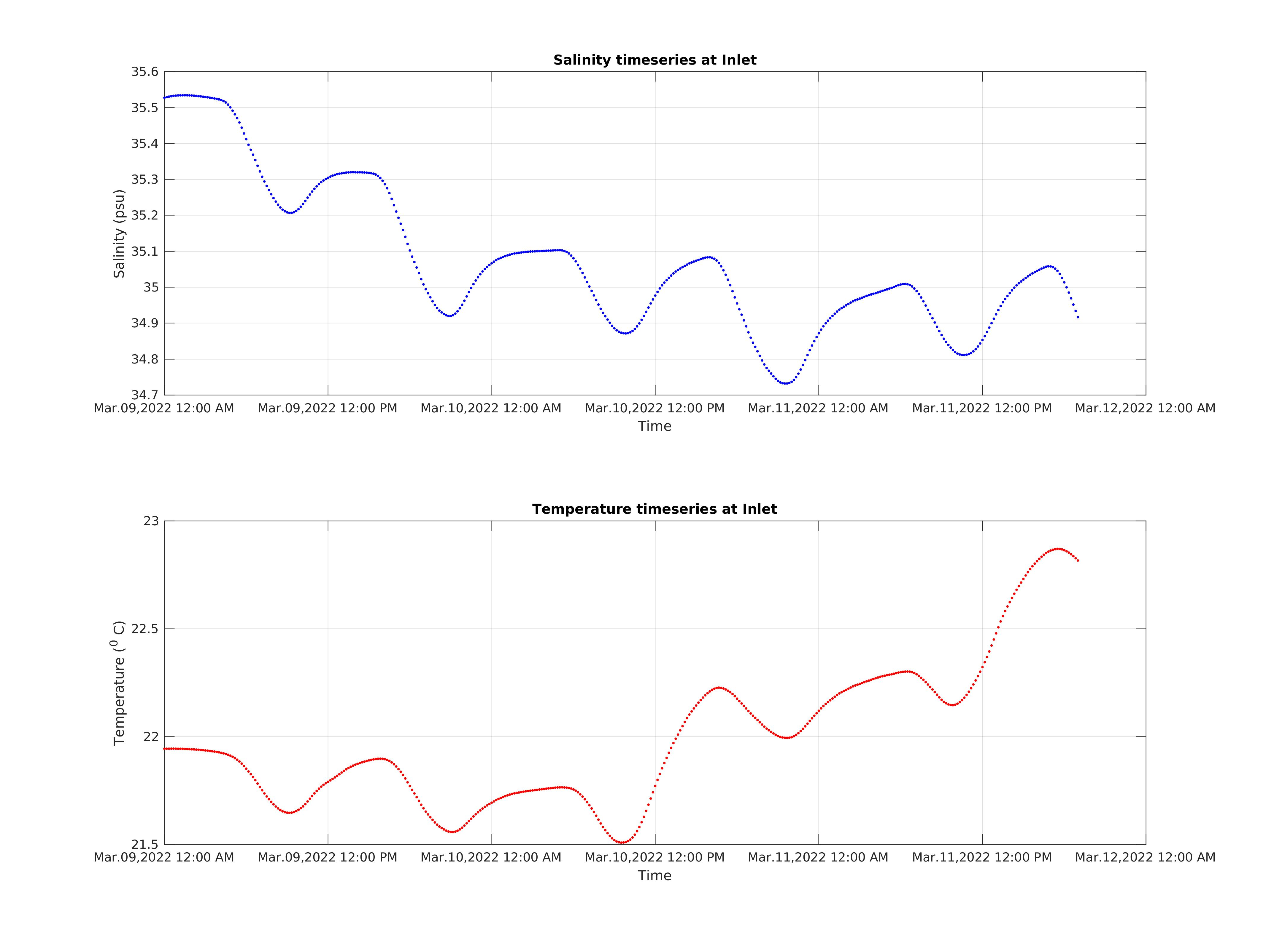
Salinity and Water Temperature Forecast: 72-Hours

Slide 11
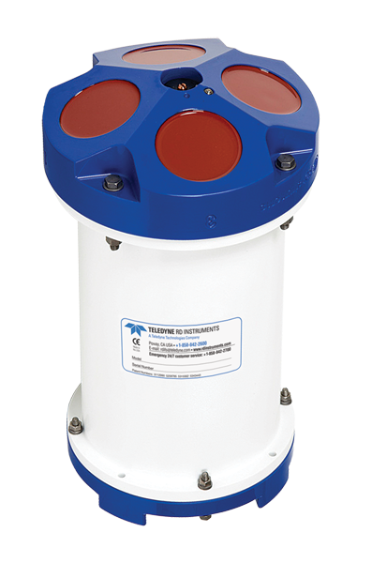
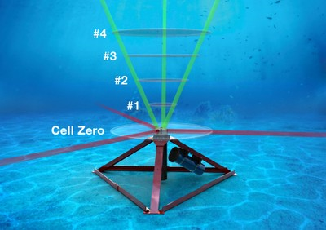
Sensors
Acoustic Doppler Current Profiler

Slide 12
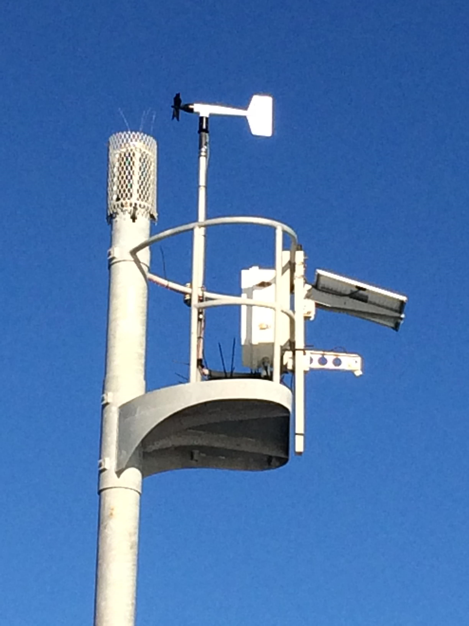
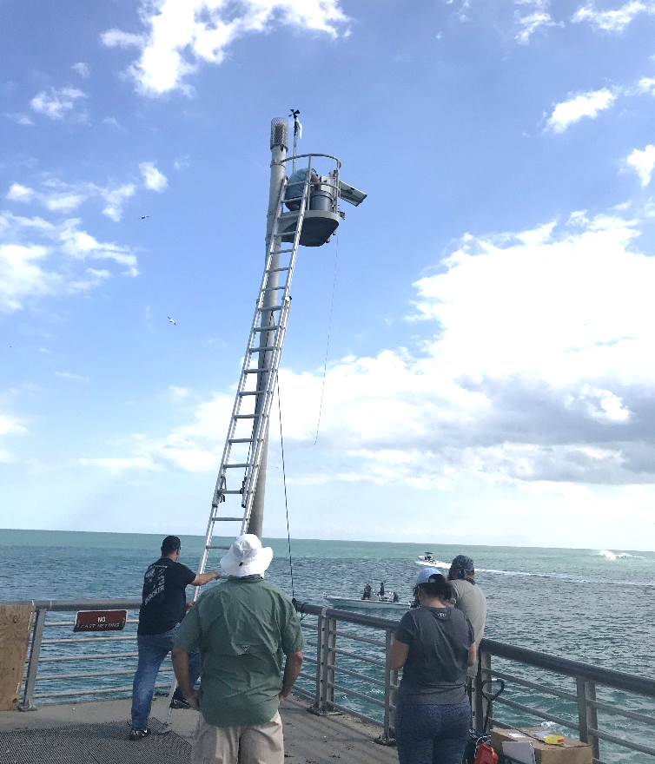
Sensors
Meteorological Station

Slide 13
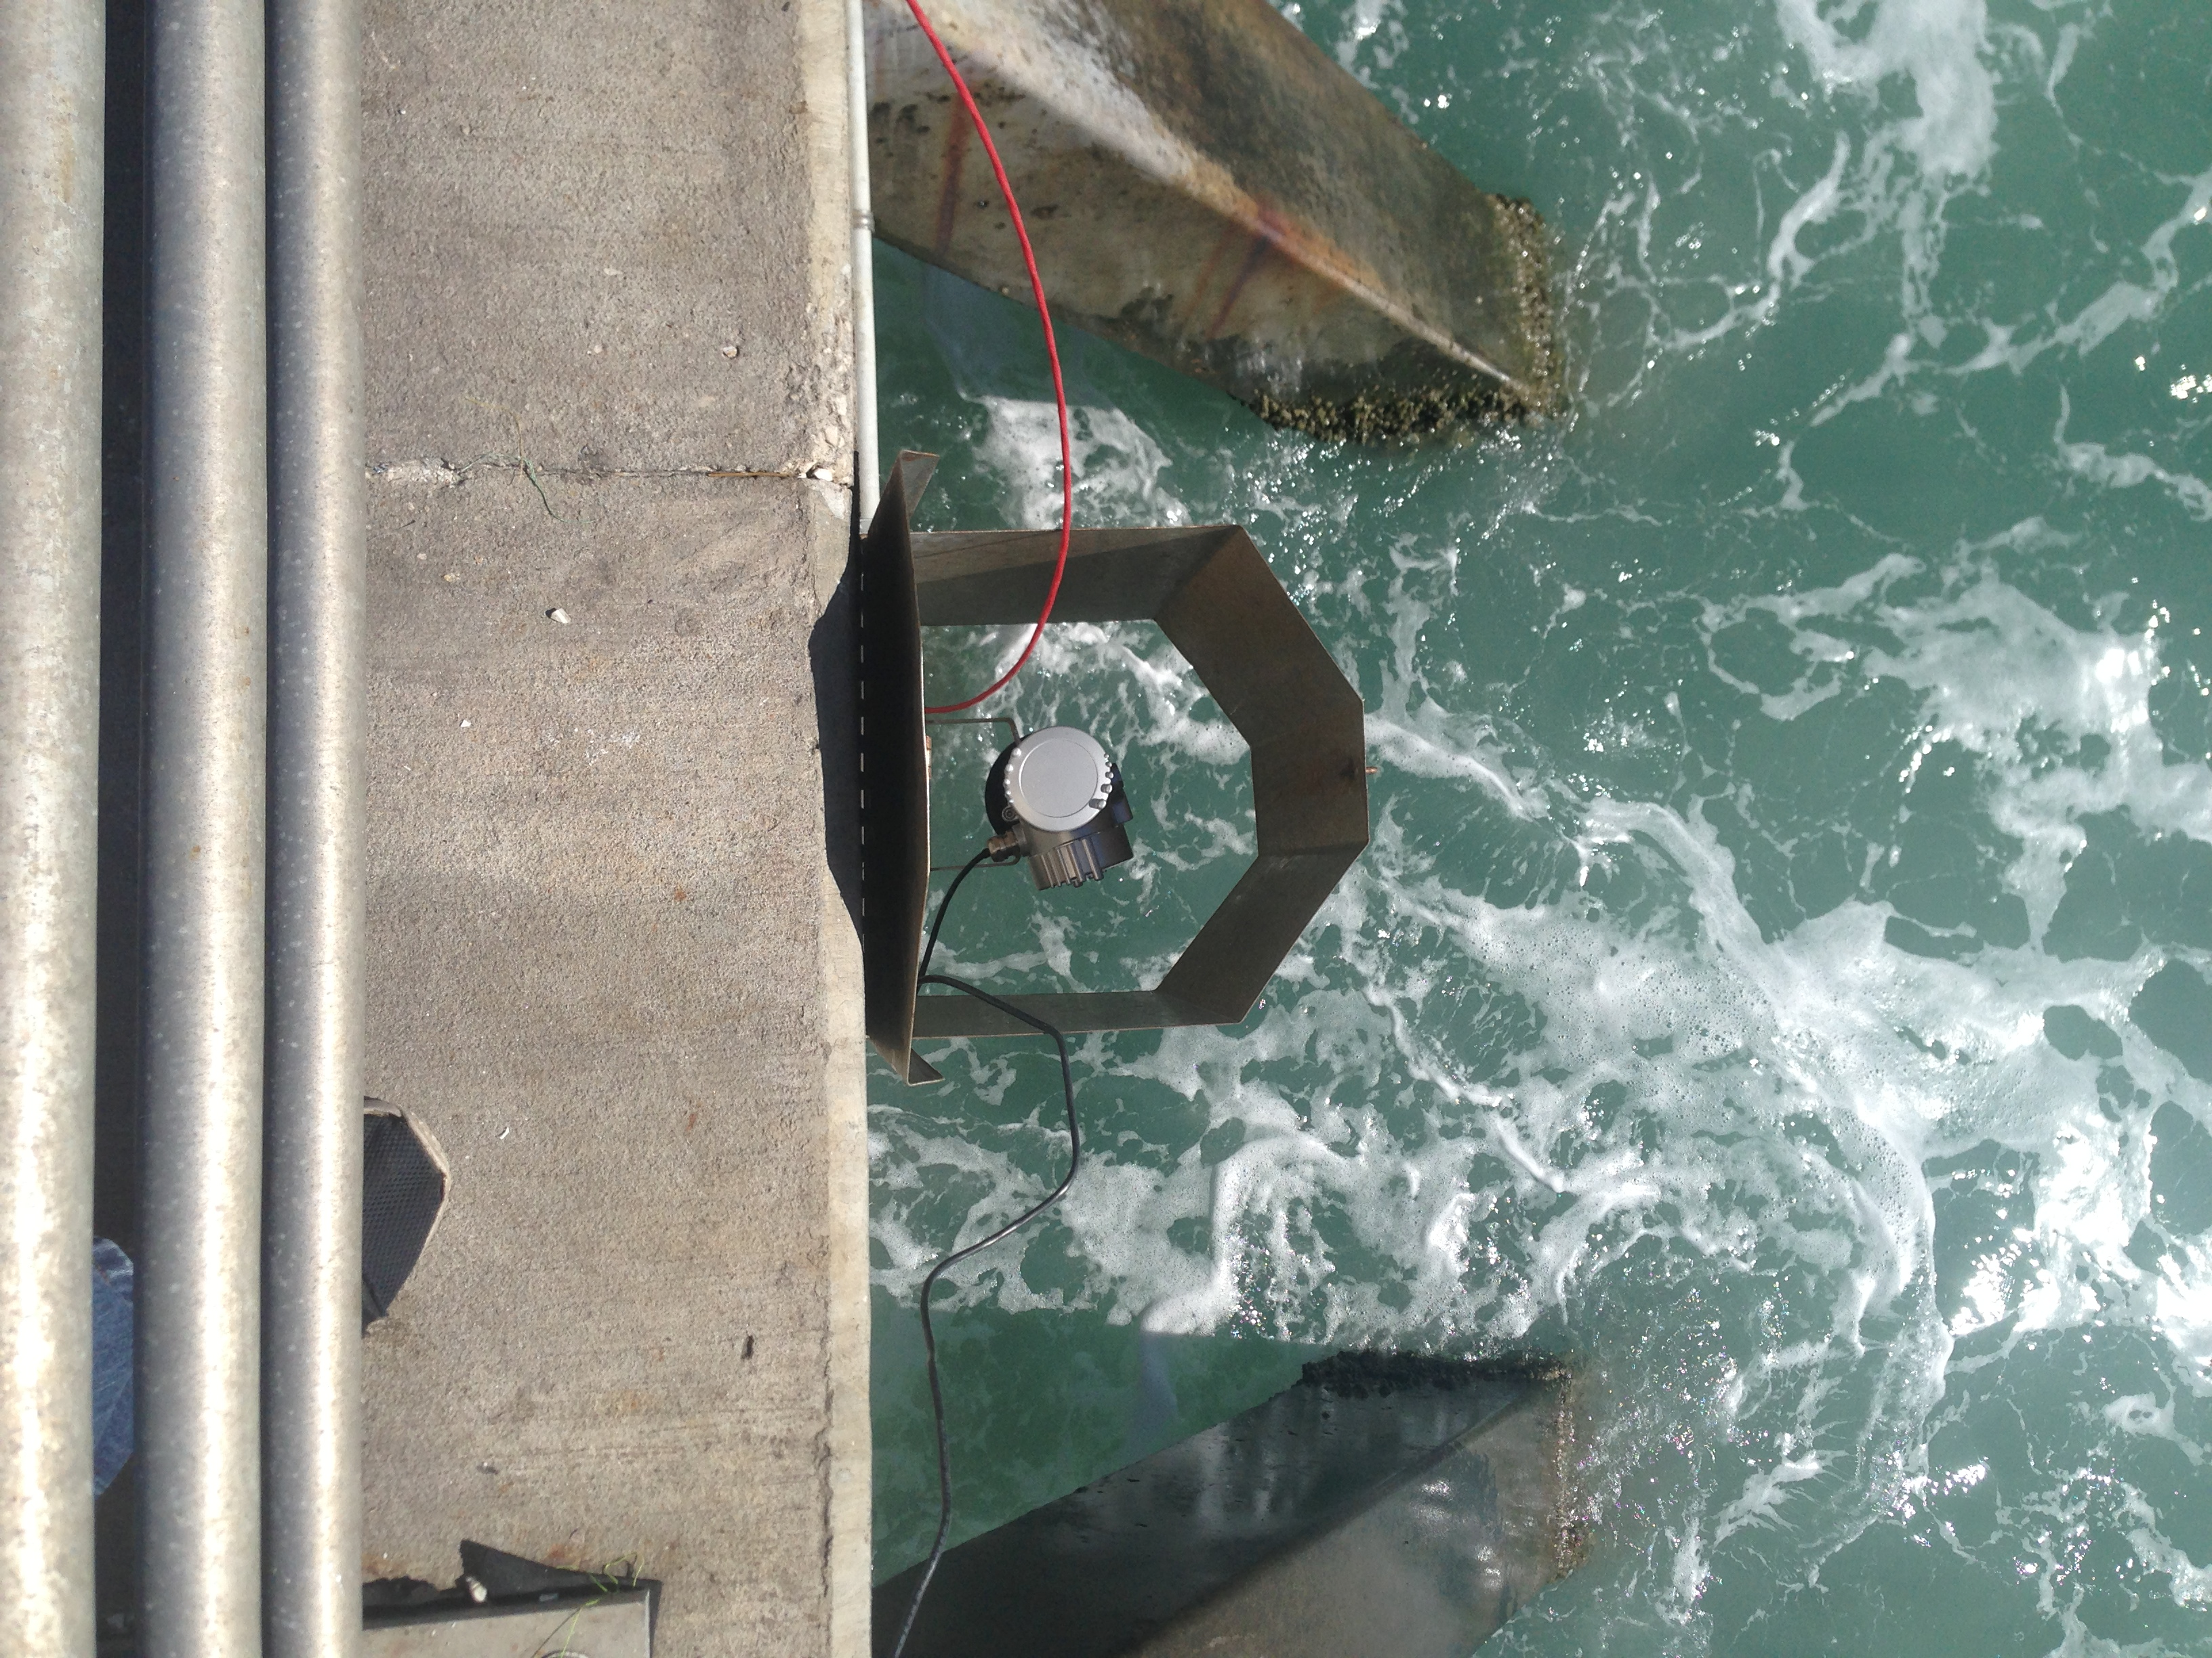
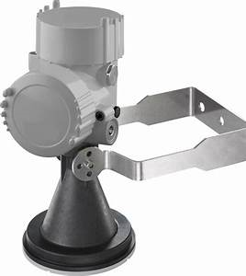
Sensors
Water Level Sensor RADAR Technology

Slide 14
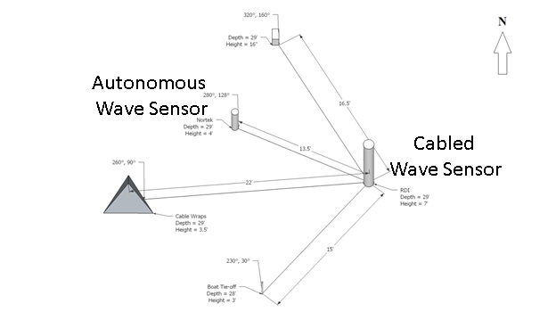
ADCP Sensor Configuration
X

Slide 15
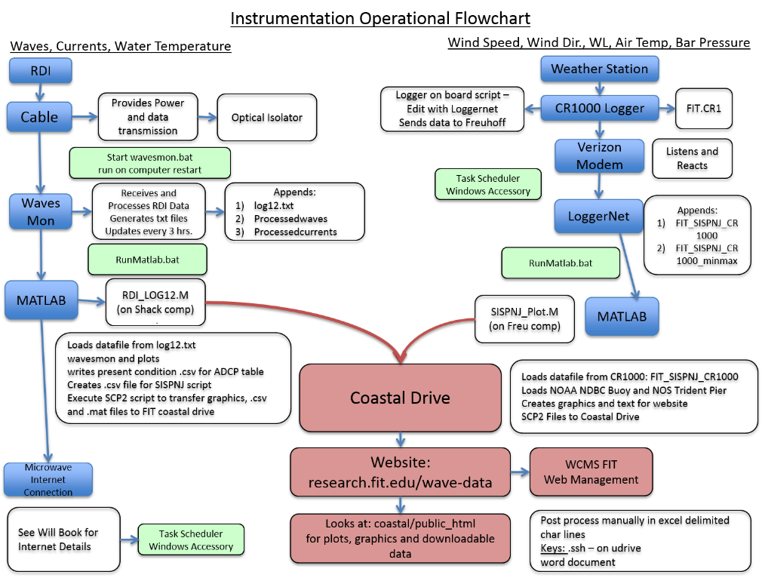
Data Flow Plan

Slide 16
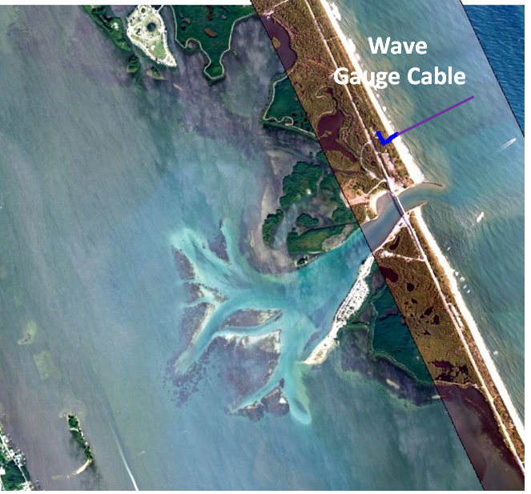
Real Time ADCP Data Cable

Slide 17
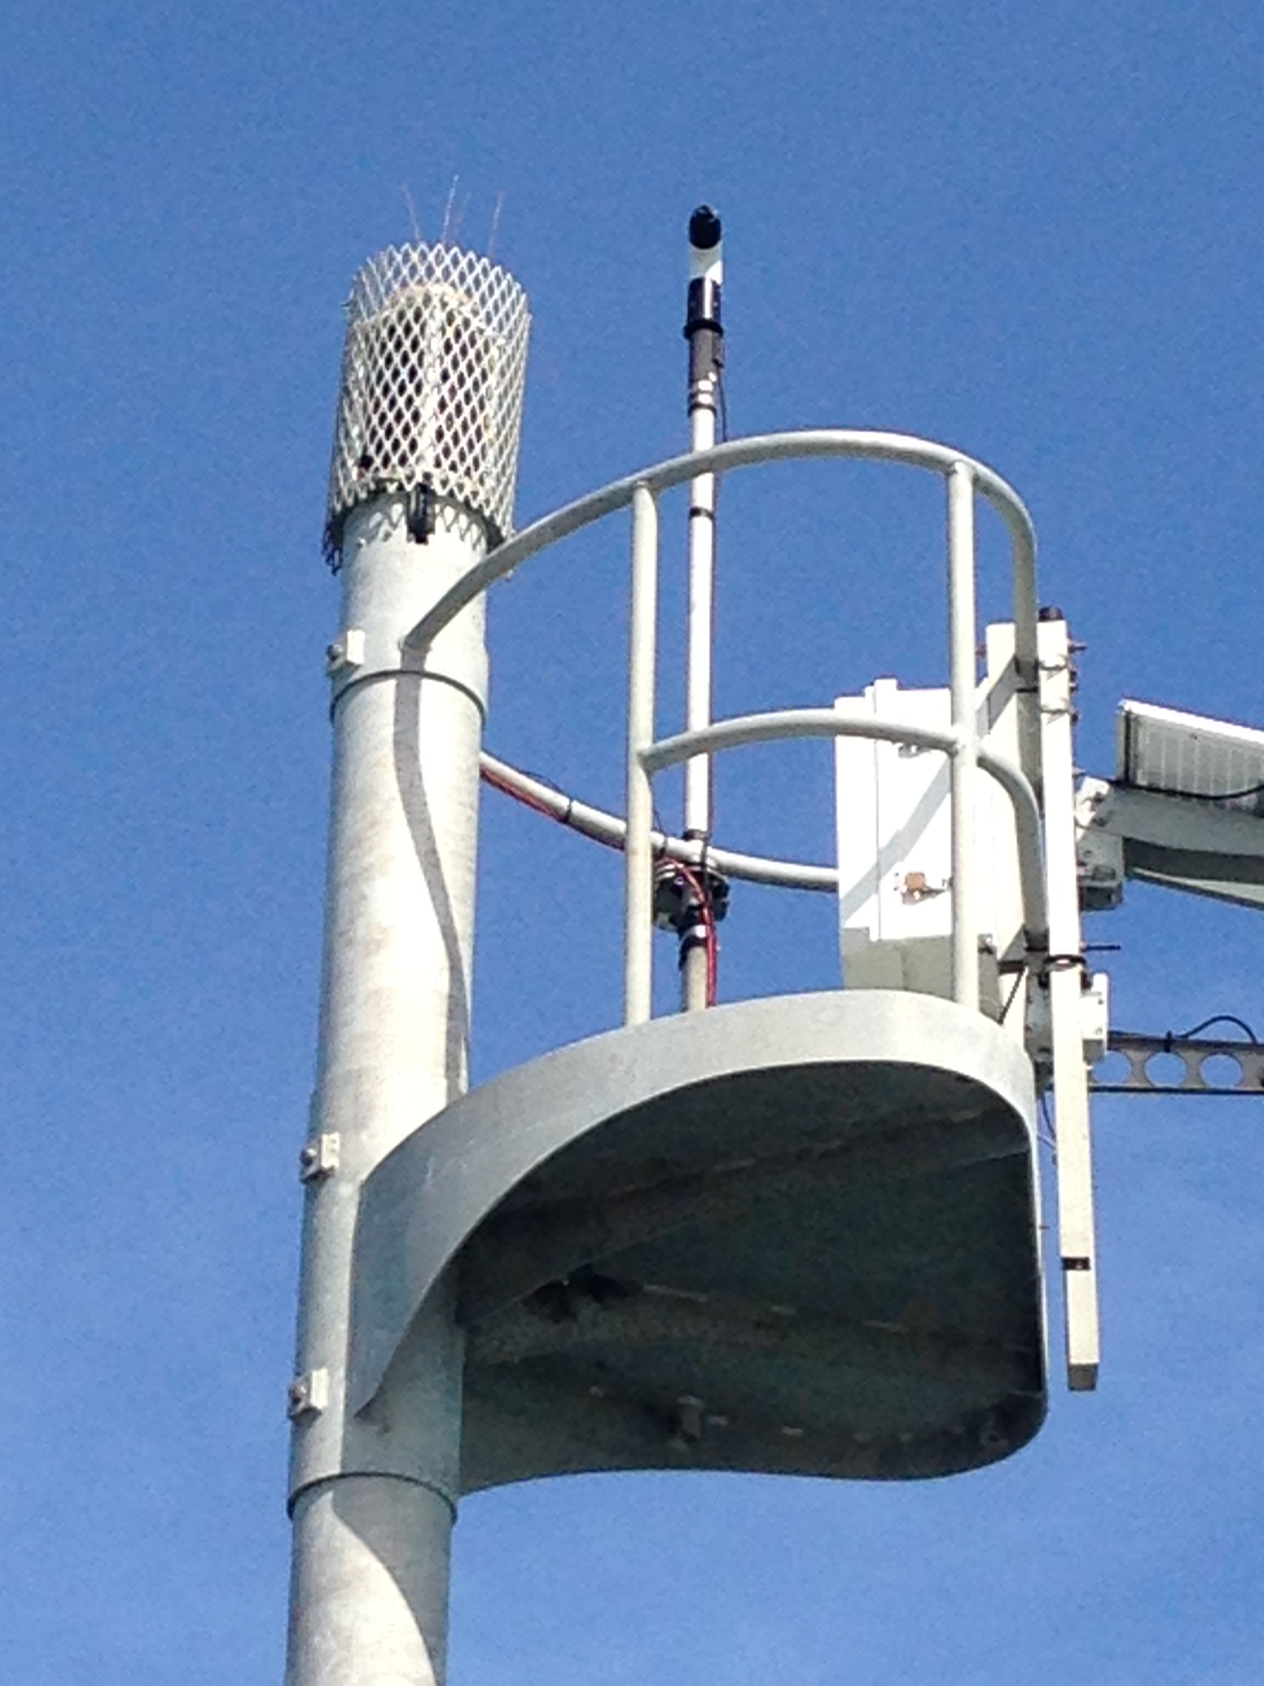
Equipment Repair and Replacements
RM Young Anemometer 2021

Slide 18
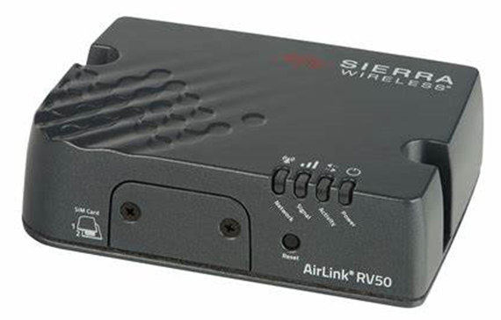
Equipment Repairs
Water Level Sensor Replacement 2020
Air Link Modem for real time communications

Slide 19
Equipment Repairs
Water Level Sensor Replacement 2020

Slide 20
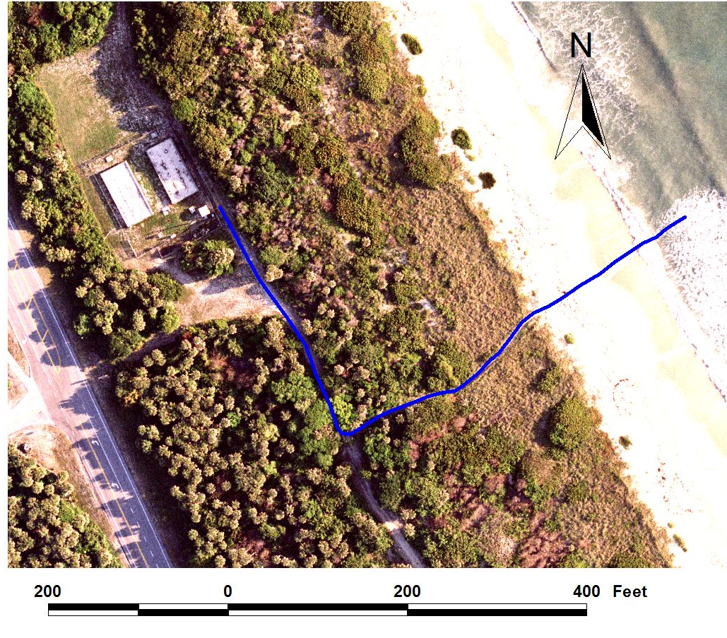
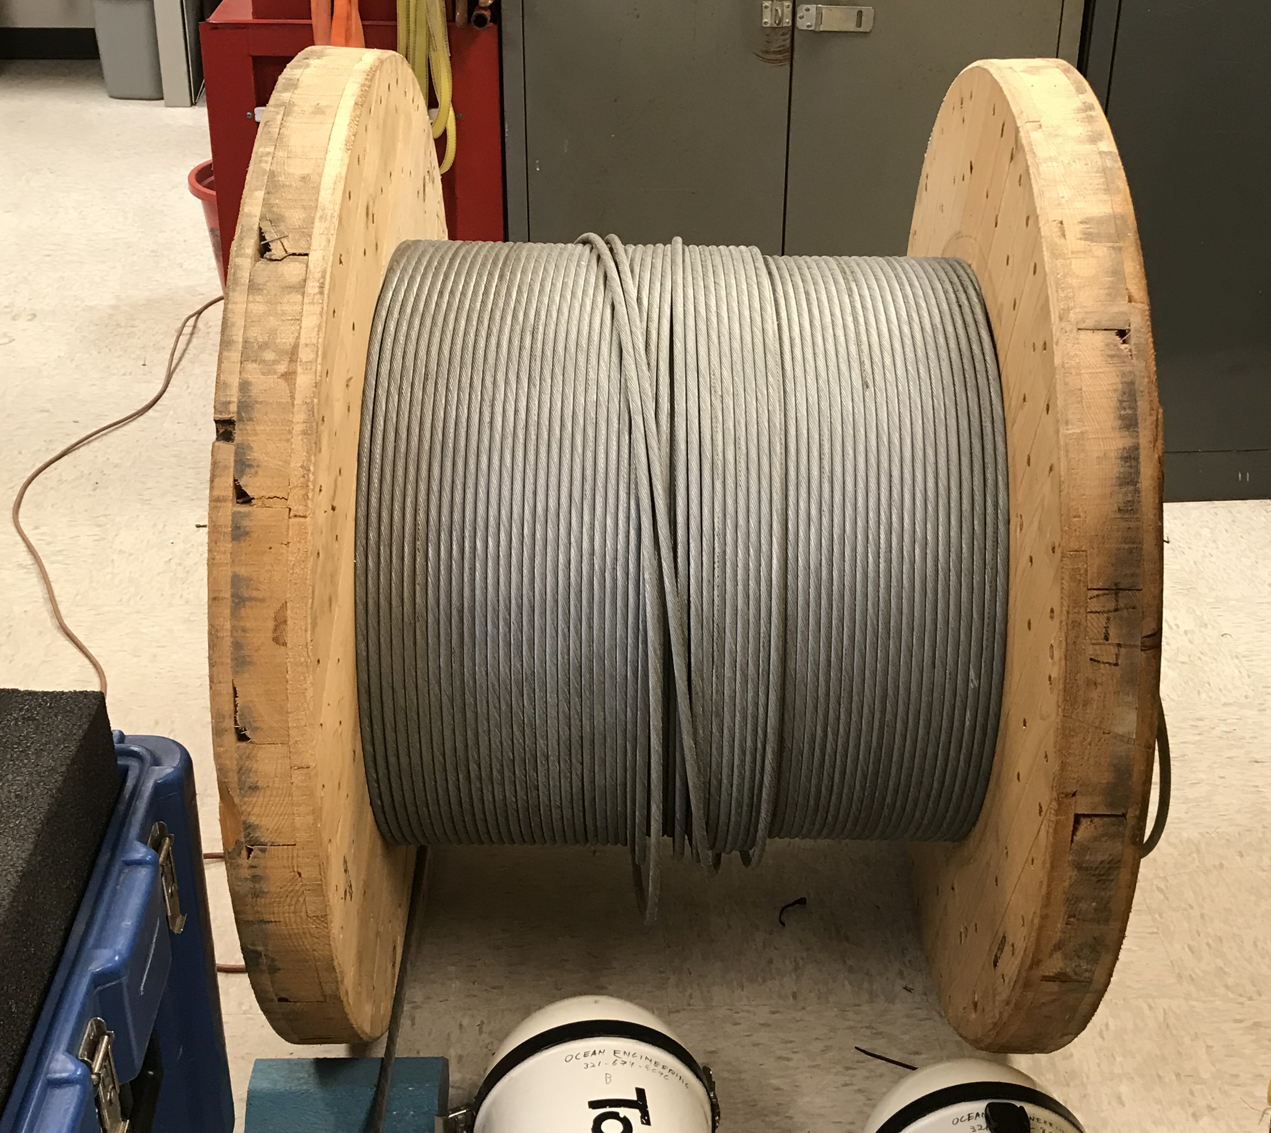
Real Time ADCP Data Cable Functioning
Data Cable Replacement 2020

Slide 21
Statistical Summary of Wave, Current Data and Weather Data
Wave Statistics: 2020-2021
 | Wave Height (m) | Wave Period (s) | Wave Direction (°TN)
Minimum | 0.2 | 2.5
Maximum | 2.9 | 18.1
Average | 0.9 | 8.9 | 66.63
Wave Statistics: 10,15,22 years: 1998-2021
 | Wave Height (m) |  |  | Wave Period (s) |  |  | Wave Direction (°TN)
 | 10yr. | 15yr. | 24yr. | 10yr. | 15yr. | 24yr. | 10yr. | 15yr. | 24yr.
Minimum | 0.14 | 0.01 | 0.01 | 1.70 | 1.70 | 1.70
Maximum | 5.10 | 5.10 | 5.10 | 18.1 | 19.50 | 20.00
Average | 0.82 | 0.80 | 0.77 | 8.67 | 8.77 | 8.67 | 69.39 | 71.00 | 70.63

Slide 22
Statistics: ADCP Currents
Current Statistics: 2020- 2021
 | Current Speed (m/s) | Current Direction (°TN)
 | 1 year | 1 year
Minimum | 0.00
Maximum | 0.51
Average | 0.11 | 156.74
Current Statistics: 10, 15 and 23 Years:1996 – 2020
 | Current Speed (m/s) |  |  | Current Direction (°TN)
 | 10yr. | 15yr. | 24yr. | 10yr. | 15yr. | 23yr.
Minimum | 0.00 | 0.00 | 0.00
Maximum | 0.76 | 1.60 | 1.60
Average | 0.10 | 0.10 | 0.11 | 185.00 | 182.75 | 180.75

Slide 23
Meteorological Statistics 2020-2021
 | Wind Speed (m/s) | Wind Direction (°TN) | Barometric Pressure (mb) | Air Temperature (°C) | Water Temp at Depth (°C)
Minimum | 0.00 |  | 973 | 5.51 | 5.14
Maximum | 22.5 |  | 1034 | 32.41 | 34.65
Average | 5.23 | 162.23 | 1018 | 23.21 | 23.24

Slide 24
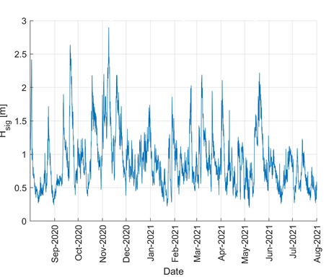
2020- 2021 Significant Wave Heights in Meters

Slide 25
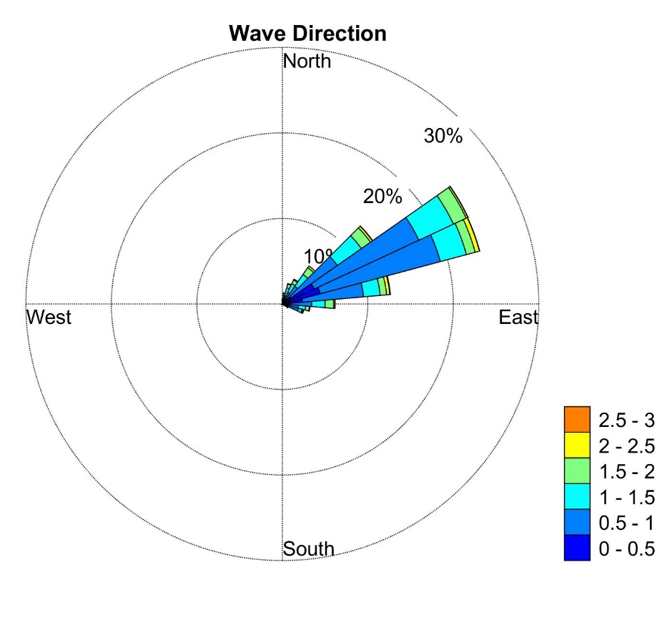
2020 - 2021 Directional Wave Height Distribution
Meters

Slide 26
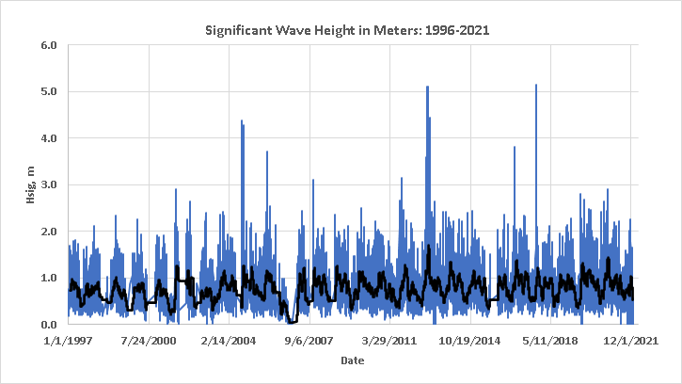
1996- 2021 Significant Wave Heights in Meters

Slide 27
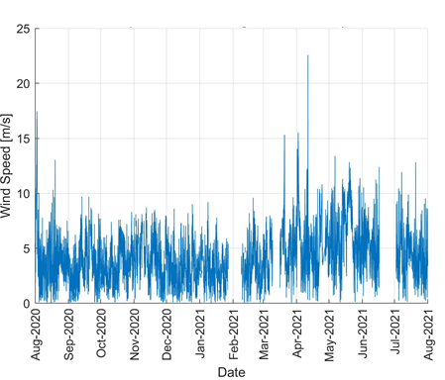
Wind Speed 2020 - 2021

Slide 28
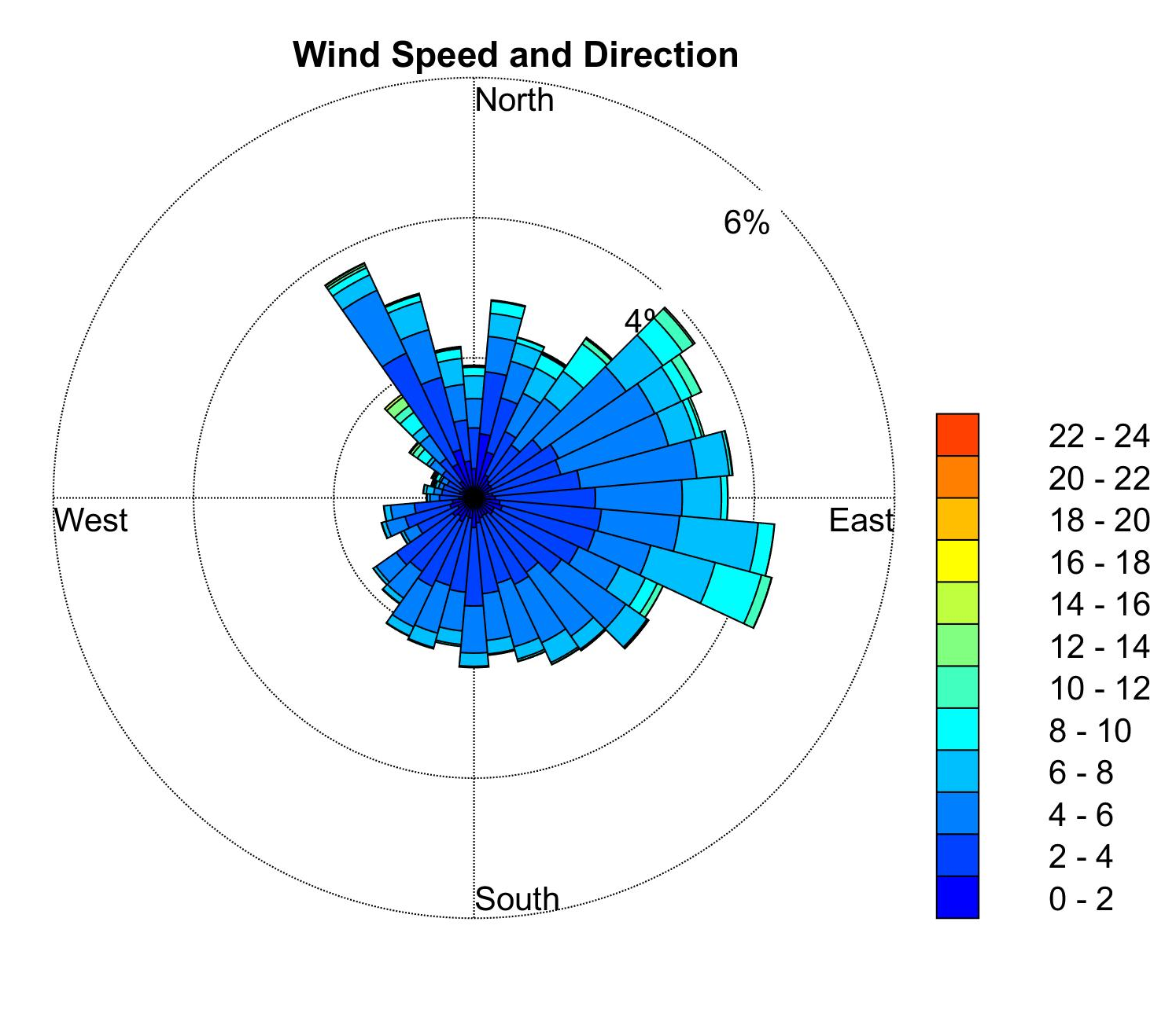
2020- 2021 Directional Wind Speed in m/s
m/s

Slide 29
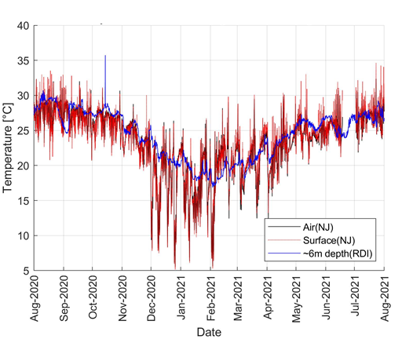
2020- 2021 Temperature Data (Water/Air)

Slide 30
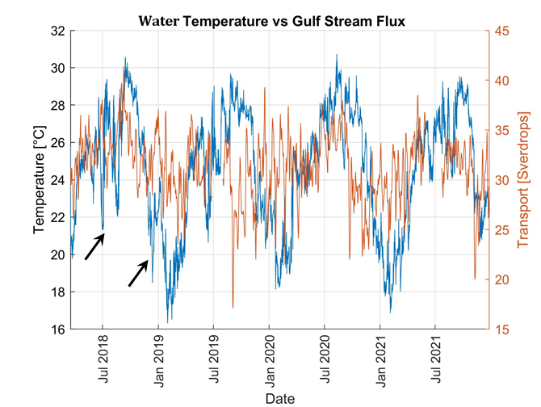
Water Temperature and Gulf Stream Flow

Slide 31
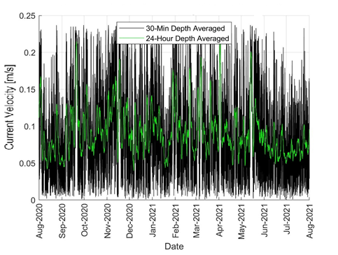
2020- 2021 Currents at the ADCP Site

Slide 32
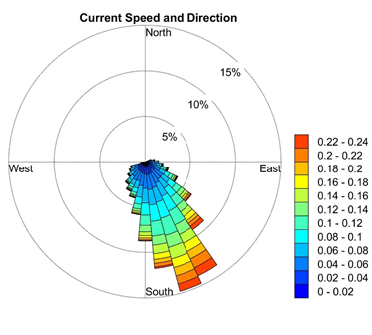
2020- 2021 Directional Currents in m/s
m/s

Slide 33
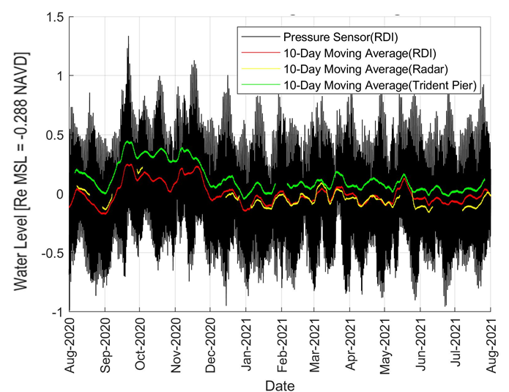
2020 - 2021 Water Level Record in Meters

Slide 34
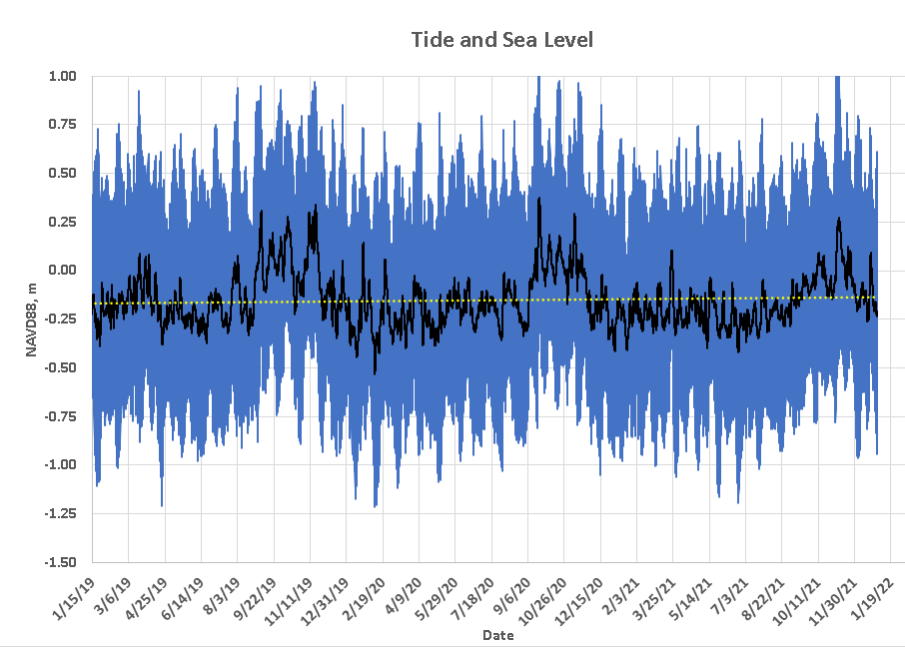
2019- 2021 Water Elevation

Slide 35
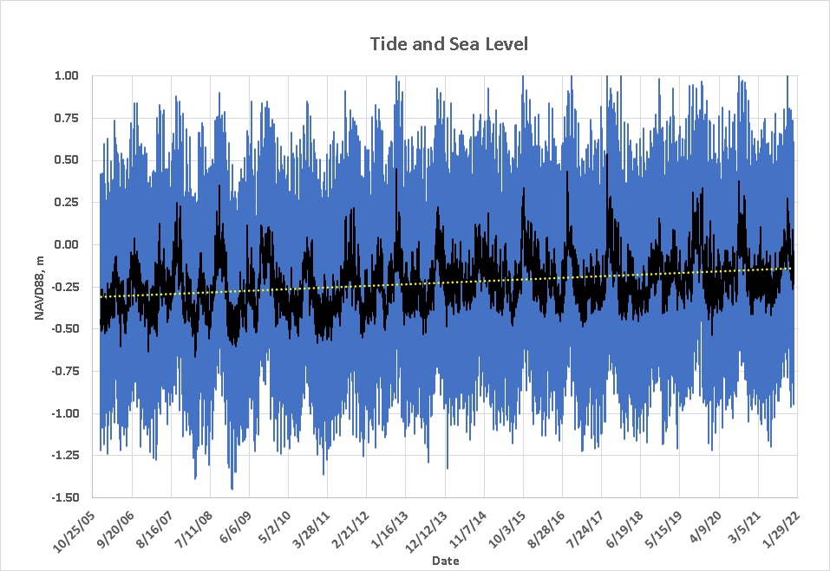
Coastal Sea Level 2005-2020
Sea Level 2005 – 2021 = +0.56 ft or about +1.1 cm/yr.

Slide 36
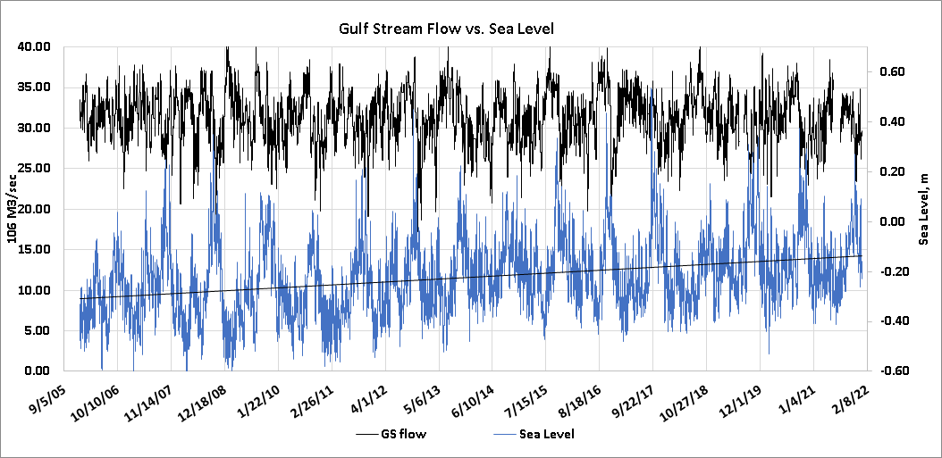
Coastal Sea Level and Gulf Stream Flow 2005-2021

Slide 37
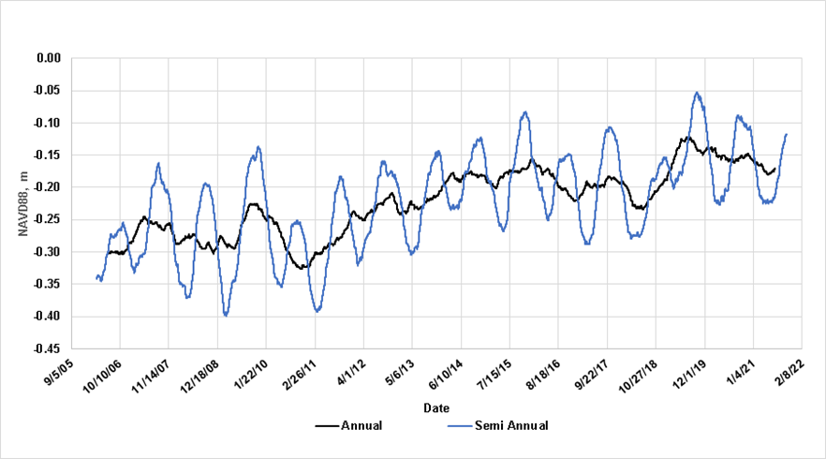
Coastal Sea Level 2006-2021

Slide 38
Acknowledgments
We would like to thank the Sebastian Inlet District for their support of this project.

